Slide 1
How a chip is made
http://apcmag.com/picture-gallery-how-a-chip-is-made.htm
November 15, 2011

Slide 2
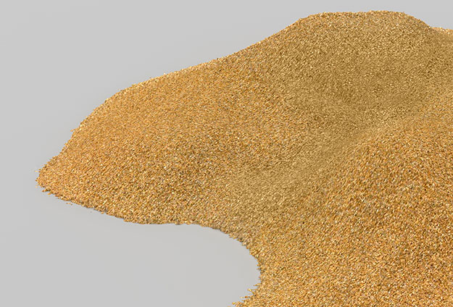
It starts with sand
With about 25% (mass) Silicon is – after Oxygen – the second most frequent chemical element in the earth’s crust. Sand – especially Quartz - has high percentages of Silicon in the form of Silicon dioxide (SiO2) and is the base ingredient for semiconductor manufacturing.

Slide 3
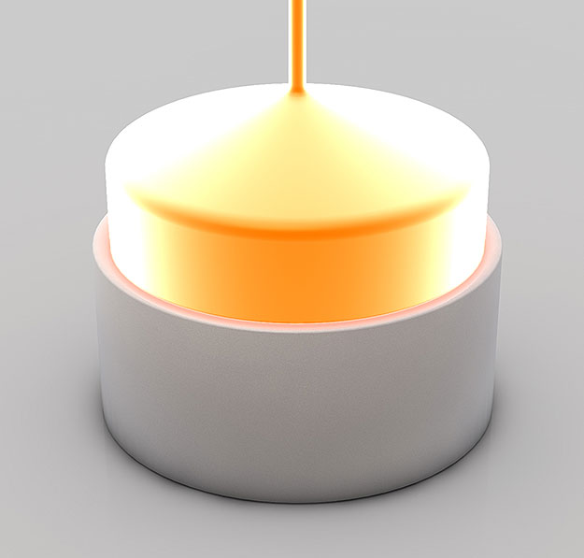
Melted Silicon
Silicon is purified in multiple steps to finally reach semiconductor manufacturing quality which is called Electronic Grade Silicon. Electronic Grade Silicon may only have one alien atom every one billion Silicon atoms. In this picture you can see how one big crystal is grown from the purified silicon melt. The resulting mono crystal is called Ingot.

Slide 4
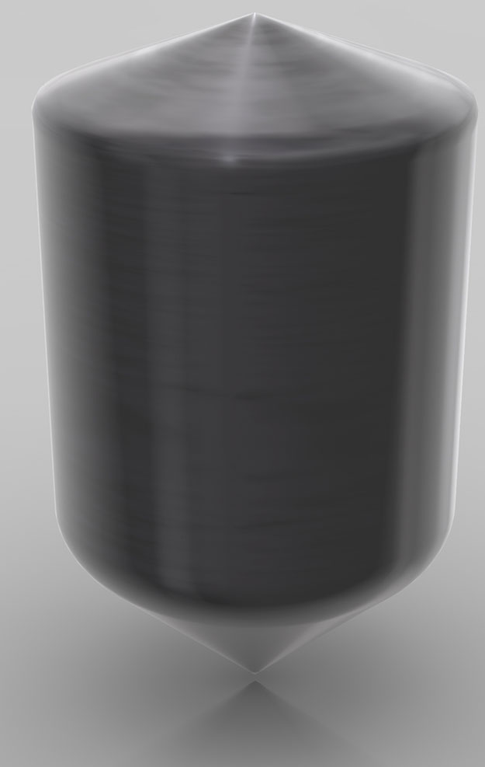
Mono-crystal Silicon Ingot
An ingot has been produced from Electronic Grade Silicon. One ingot weights about 100 kilograms (=220 pounds) and has a Silicon purity of 99.9999%.

Slide 5
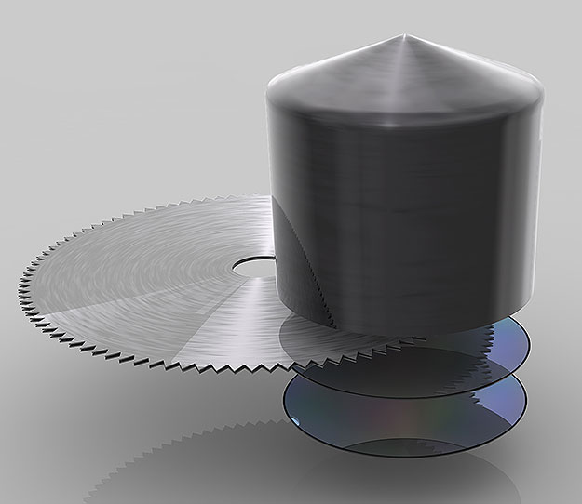
Ingot Slicing
The Ingot is cut into individual silicon discs called wafers.

Slide 6
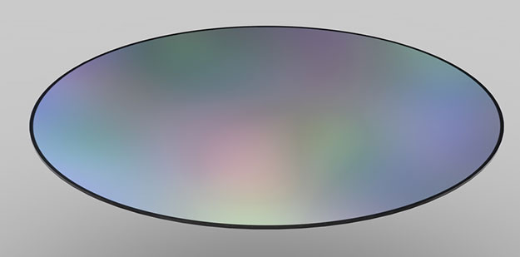
Wafer
The wafers are polished until they have flawless, mirror-smooth surfaces. Intel buys those manufacturing ready wafers from third party companies. Intel’s highly advanced 45nm High-K/Metal Gate process uses wafers with a diameter of 300 millimeter (~12 inches). When Intel first began making chips, the company printed circuits on 2-inch (50mm) wafers. Now the company uses 300mm wafers, resulting in decreased costs per chip.

Slide 7
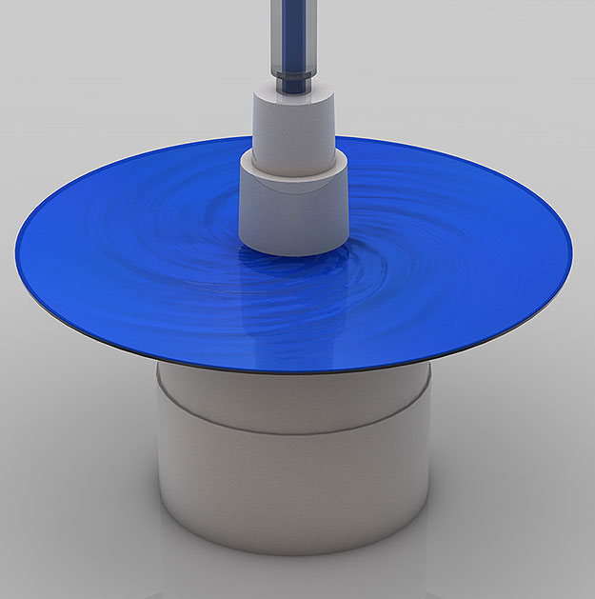
Applying Photo Resist
The liquid (blue here) that’s poured onto the wafer while it spins is a photo resist finish similar as the one known from film photography. The wafer spins during this step to allow very thin and even application of this photo resist layer.

Slide 8
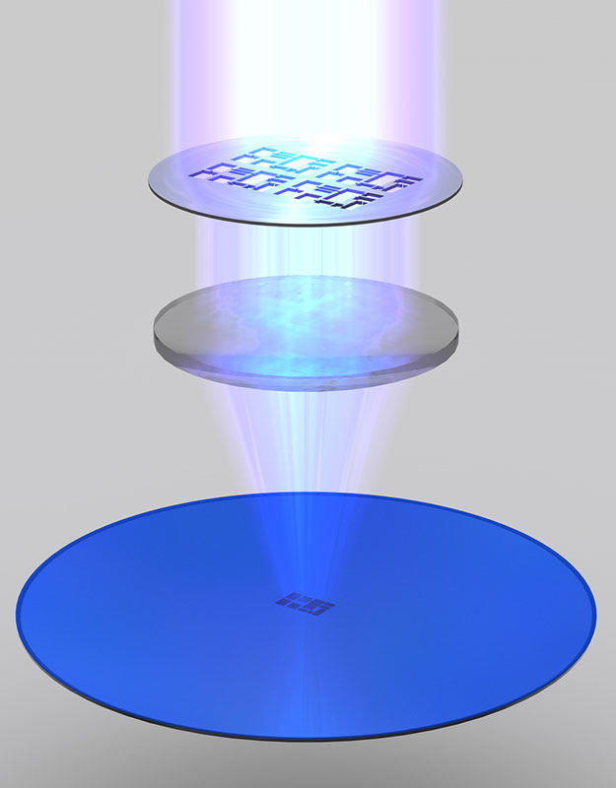
Exposure
The photo resist finish is exposed to ultra violet (UV) light. The chemical reaction triggered by that process step is similar to what happens to film material in a film camera the moment you press the shutter button. The photo resist finish that’s exposed to UV light will become soluble. The exposure is done using masks that act like stencils in this process step. When used with UV light, masks create the various circuit patterns on each layer of the microprocessor. A lens (middle) reduces the mask’s image. So what gets printed on the wafer is typically four times smaller linearly than the mask’s pattern.

Slide 9
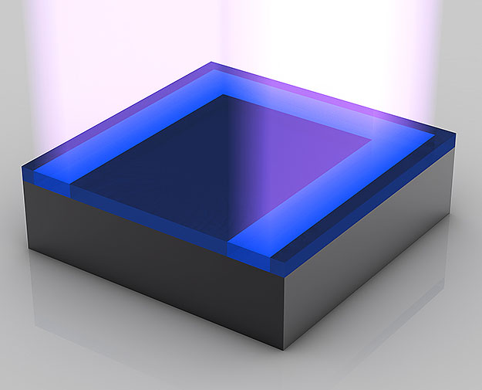
Exposure
Although usually hundreds of microprocessors are built on a single wafer, this picture story will only focus on a small piece of a microprocessor from now on –on a transistor or parts thereof. A transistor acts as a switch, controlling the flow of electrical current in a computer chip. Intel researchers have developed transistors so small that about 30 million of them could fit on the head of a pin.

Slide 10
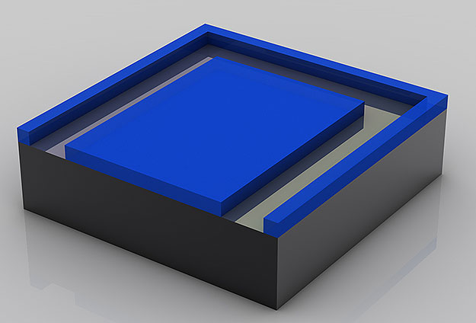
Washing off of Photo Resist
The gooey photo resist is completely dissolved by a solvent. This reveals a pattern of photo resist made by the mask.

